Slide 1
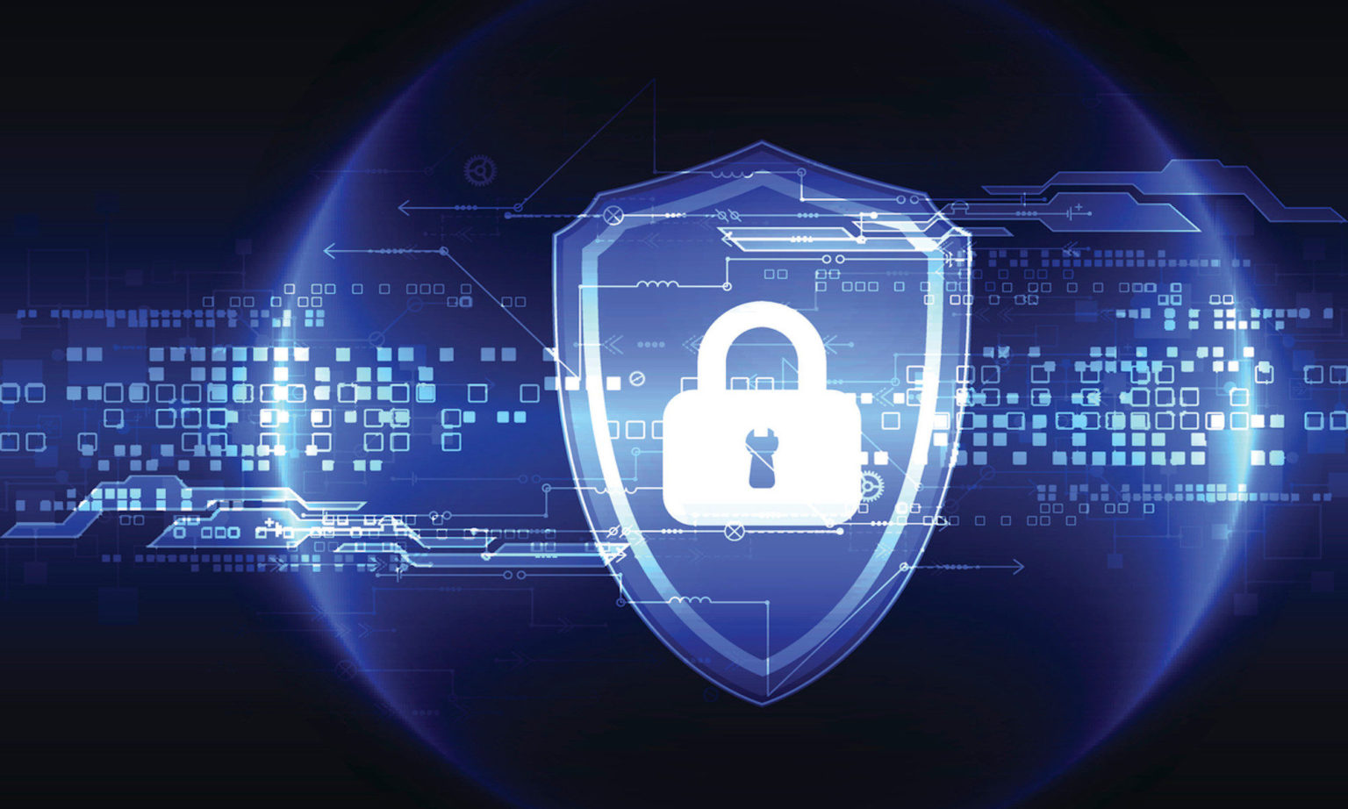
SEMINAR
Mobile Forensics Data Integrity Assessment by Event Monitoring
This Photo by Unknown Author is licensed under CC BY-SA

Slide 2

CONTENT
ABSTRACT
INTRODUCTION
MOBILE FORENSICS
DATA INTEGRITY
EVENT MONITORING
EXISTING SYSTEM
MIAT TOOL
PROPOSED SYSTEM
FSMon APPLICATION
DATA INTEGRITY BY IEVENT MONITORING
WORK FLOW DIAGRAM
RESULT
FUTURE SCOPE
CONCXLUSION
REFERENCE

Slide 3

ABSTRACT
Mobile forensics is a field of digital forensics that deals with the extraction and analysis of digital evidence from mobile devices.
Currently, the most forensic acquisition and analysis of mobile devices is based on tools implementing a remote paradigm, dealing with a forensic workstation used for seizure, via insertion of a piece of code in the mobile device.
In this paper, we present a new approach to assess the integrity respect regarding both the acquisition tools used and the occurring events.
By monitoring these events, forensic investigators can obtain valuable information about the user's behavior and the data that is stored on the device.
Event monitoring involves monitoring the activities and events that occur on a mobile device. This can include tracking the applications that are installed and used on the device, as well as monitoring the device's network connections, calls, text messages, and other activities.

Slide 4

INTRODUCTION
Mobile Phones (MPs) currently represent one of the most diffused technologies all over the world the number of subscribers overcame 2 billions of units and this number seems to follow an increasing trend.
In this scenario, the number of MPs implicated in crime activities is relevant and it is growing up .
Mobile forensics is a field of digital forensics that deals with the extraction and analysis of digital evidence from mobile devices.
Mobile Forensics Data Integrity Assessment is the process of verifying that the data retrieved from a mobile device is accurate, complete, and reliable. This process involves the use of various forensic techniques to identify and recover digital evidence from mobile devices.

Slide 5
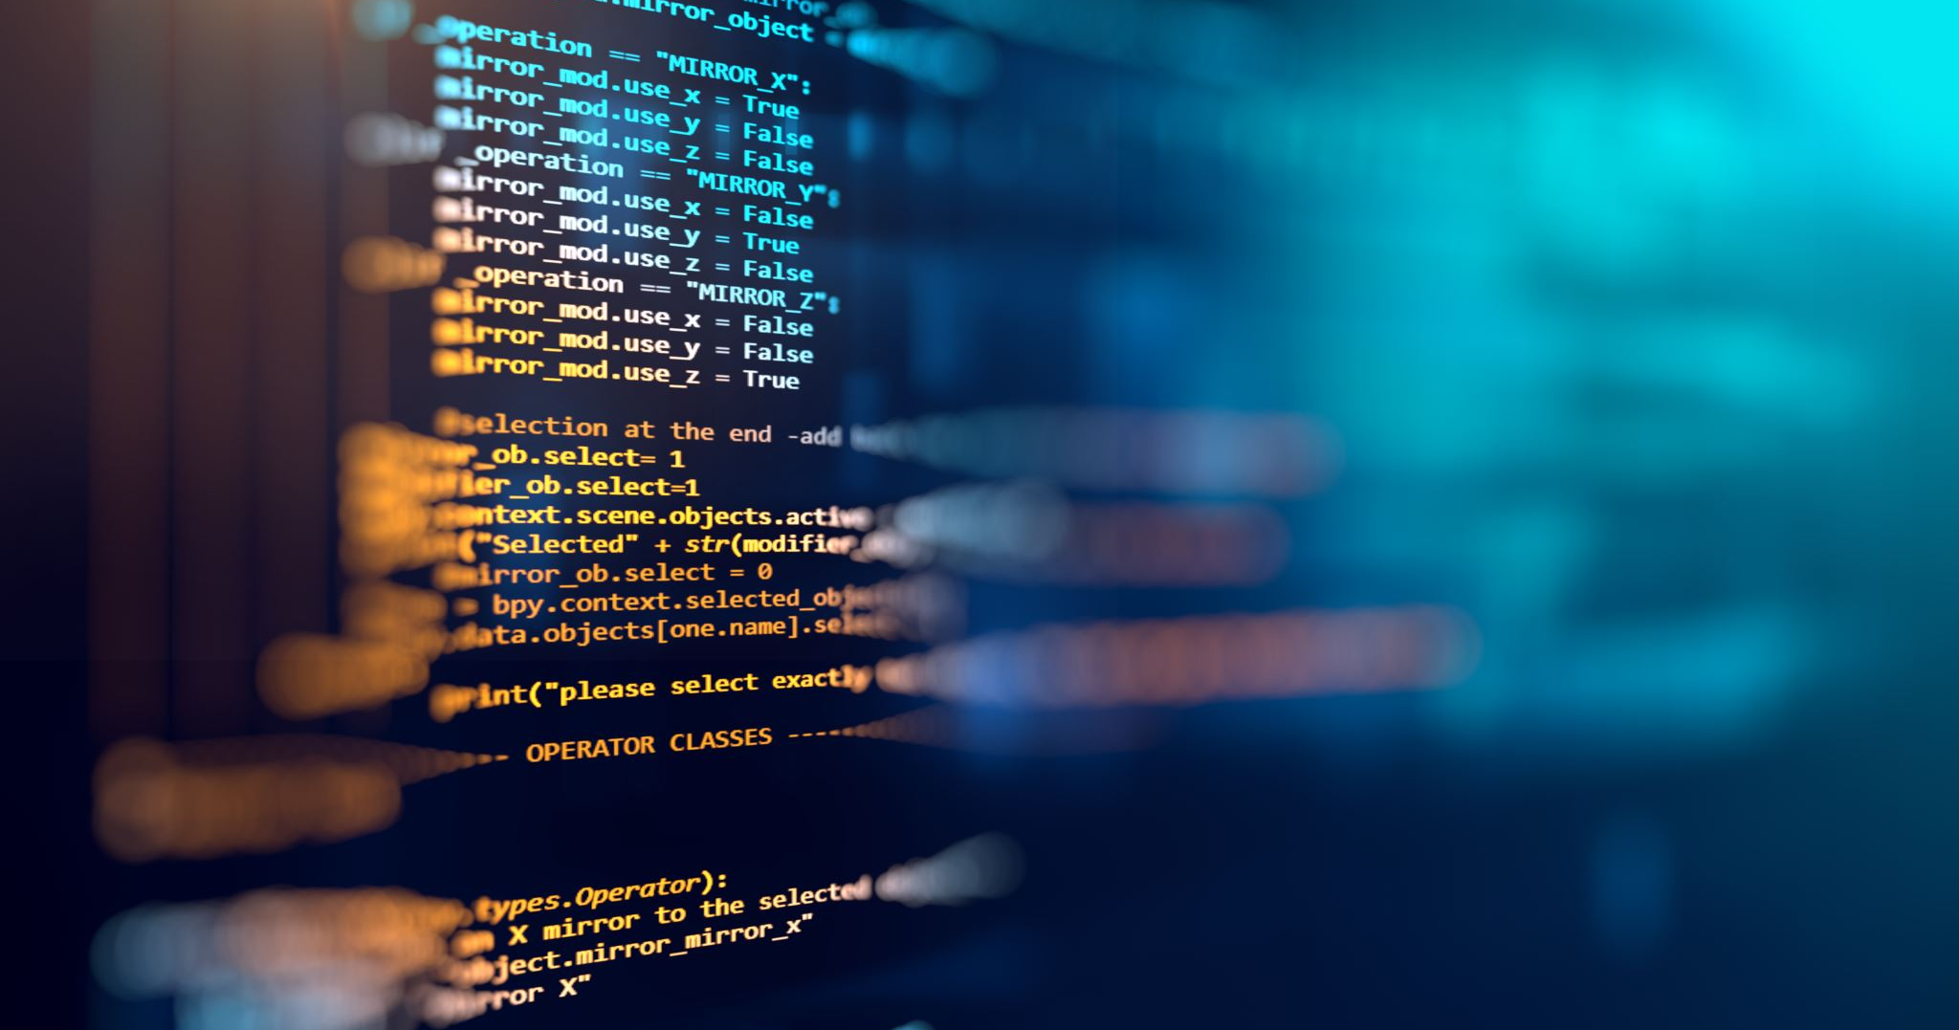
MOBILE FORENSIC
Mobile forensics is the process of collecting, analyzing, and preserving data from mobile devices for the purpose of investigation or legal proceedings.
It involves a wide range of techniques and tools to extract data from devices such as smart phones, tablets, and wearable technology.
Mobile forensics is a critical component of digital forensics, as mobile devices are becoming more ubiquitous and increasingly contain sensitive information.
The goal of mobile forensics is to obtain evidence that can be used in criminal or civil proceedings
This can include information such as call logs, text messages, email correspondence, internet browsing history, and GPS data.

Slide 6
MOBILE FORENSIC
The mobile forensics process typically involves four stages:
Collection: The first step is to obtain physical or logical access to the mobile device
Extraction: Once access to the device has been obtained, data is extracted from the device using a variety of techniques
Analysis: Once data has been extracted from the device, it is analyzed to identify evidence that can be used in a legal case.
Reporting: Finally, the results of the analysis are compiled into a report that can be used in legal proceedings.

Slide 7
DATA INTEGRITY
Data integrity assessment is the process of ensuring that the data obtained from the device is accurate and reliable.
In order to do this, forensic investigators need to verify that the data has not been altered or tampered with in any way.
There are several techniques that can be used to assess data integrity in mobile forensics, including the following.
Hashing: Hashing is a technique that involves generating a unique digital signature, or hash value, for a piece of data. a. This hash value can be used to verify the integrity of the data by comparing it to the original hash value.

Slide 8
DATA INTEGRITY
Timeline analysis: Timeline analysis involves creating a chronological timeline of the events and activities that occurred on the device.
Comparison with known data:: Forensic investigators can compare the data obtained from the device with known data, such as data obtained from backups or other sources.
Event monitoring: Event monitoring can also be used to assess data integrity by providing a real-time view of the activities and events that are occurring on the device.

Slide 9
EVENT MONITORING
Event monitoring is an important component of mobile forensics that involves the real-time collection and analysis of events and activities occurring on a mobile device.
This can include actions such as opening an app, making a phone call, sending a text message, or browsing the internet.
By monitoring these events, forensic investigators can gain valuable insights into the actions and behavior of the device's user.

Slide 10
EXISTING SYSTEM
Currently, the most forensic acquisition and analysis of these devices is based on tools implementing a remote paradigm, dealing with a forensic workstation used for seizure, via insertion of a piece of code in the mobile device; therefore, the characterization of integrity respect is still difficult and needs to be investigated in depth.
Currently, as the validation of forensic tools is a complicated and expensive task, a lot of manufacturers seem to be more likely interested in functionalities rather than strong validation of their forensic tools.

Slide 11
DISADVANTAGE OF EXISTING SYSTEM
Trough the existing system methods the events occurred will affect the integrity of the data which is collected in the investigation time .
Even the commercial forensic tools are tested over a restricted number of devices; furthermore, the access to devices that have been seized in real investigations is limited by law.
The approach presented has not the granularity required to assess if the corruption is due to the acquisition process or to another cause, because the compared images are collected using the same forensic tools which are under study.

Slide 12
MIAT TOOL
The Mobile Internal Acquisition Tool (MIAT) is a free and open-source tool used in mobile forensics investigations.
It is designed to assist forensic investigators in acquiring data from mobile devices at the internal level, such as acquiring data from the device's memory or data stored in the device's processor.
MIAT is a command-line tool that can be used to acquire data from Android and iOS devices.
Mobile Internal Acquisition Tool is a software application which can be installed directly on the smart phone using a removable memory card as an installation volume.

Slide 13
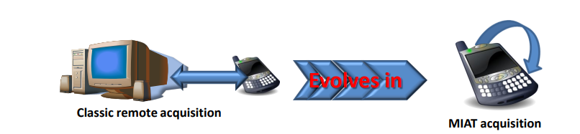
MIAT TOOL

Slide 14
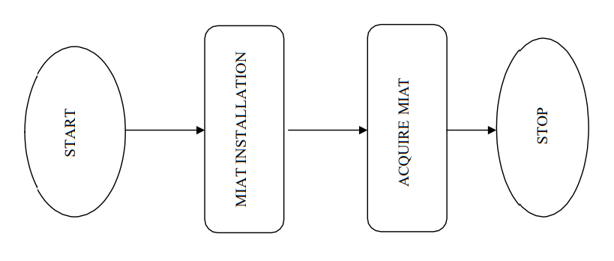
MIAT WORK FLOW DIAGRAM

Slide 15
PROPOSED SYSTEM
The proposed system is a system which work on the basis of monitoring the events. Event monitoring is a technique used to monitor the events that occur on a mobile device.
This technique involves the use of software tools that can capture and log various events that occur on the device.
These events may include incoming and outgoing calls, SMS messages, internet browsing history, and apps location data. The data collected through event monitoring can be used to verify the accuracy and completeness of the data retrieved from the device.

Slide 16
FSMon APPLICATION
FSMon is an open-source application that monitors changes to the file system on a computer.
It is designed to track and log changes made to files and directories, including additions, modifications, and deletions.
FSMon is useful for a variety of purposes, such as monitoring system events, detecting suspicious activity, and tracking changes made by an application or user.

Slide 17
FSMon APPLICATION
FSMon can be executed in the two different modes:
Notification Waiting: when FSMon is spawned in Notification Waiting mode it uses and endless loop. Each iteration waits for a notification and, as it occurs, collects last modification time data for each entry currently present in the file system
File System Structure Imaging: when FSMon is spawned in File System Structure Imaging mode, it performs a fast image of the file system tree, including last modification time for each file entry.

Slide 18
DATA INTEGRITY BY EVENT MONITORING
The working of this method is by monitoring the events while we collecting the evidence from the mobile phone.
The events like calls ,messages etc.. Can be cause the integrity of the data while we working on recovering the evidence.
This will be cause the integrity of the data as a result the evidence will be corrupted and it will not help in the investigation process.

Slide 19
DATA INTEGRITY BY EVENT MONITORING
There are steps that can be used to assess data integrity in mobile forensics.
Planning:. This involves identifying the objectives of the investigation and the mobile devices to be analyzed. It is essential to determine the scope of the investigation and the data that needs to be collected.
Device Acquisition: The next step is to acquire the mobile device. This can be done either through physical or logical acquisition. In physical acquisition, the device is connected to a forensic workstation and a bit-by-bit copy of the device's storage is created. In logical acquisition, a copy of the device's logical storage is created using software tools.

Slide 20
DATA INTEGRITY BY EVENT MONITORING
Event Monitoring : Event monitoring involves monitoring the device for any changes or events that occur during the investigation. This includes tracking the installation and removal of applications, changes to system settings, and any other activities that could impact the data being collected.
Data Analysis: This involves reviewing the logs and other data collected during the investigation. The goal of data analysis is to identify any anomalies or inconsistencies in the data that could indicate a breach of data integrity.

Slide 21
DATA INTEGRITY BY EVENT MONITORING
Reporting : The final step in Mobile Forensics Data Integrity Assessment by Event Monitoring is to create a report. This report should include a summary of the investigation, the data collected, and any anomalies or inconsistencies identified during the analysis. The report should also include a conclusion about the integrity of the data and any recommendations for future investigations.

Slide 22
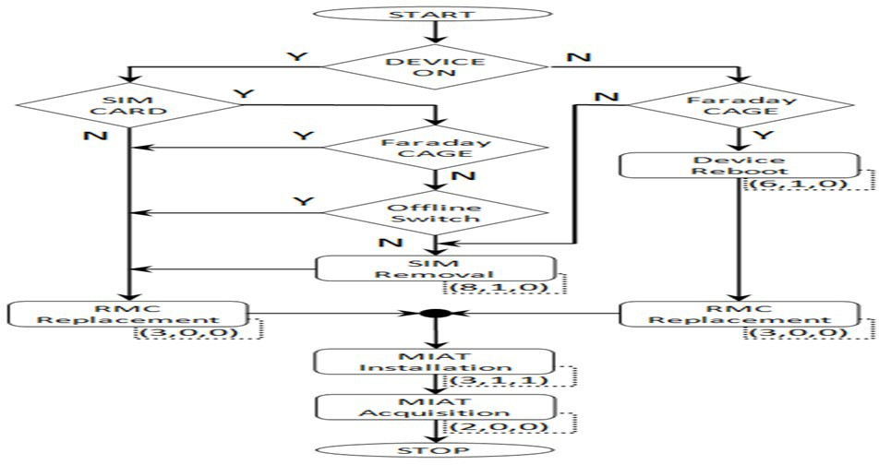
WORK FLOW DIAGRAM

Slide 23
RESULT
In this paper, we presented a new strategy to characterize the internal memory file system corruption due both to forensic tools and occurring events; our strategy is applicable to Open Source and to commercial tools as well.
Further experimental results allowed performing a characterization of the entire MIAT collection workflow; such characterization could guide the forensic operators throughout the management of devices discovered in crime scenes, in order to minimize the degree of corruption.

Slide 24
FUTURE SCOPE
This system is partially automated as an human is required to implement the process of integrity verification . In future we can develop an AI for the fully automation of the process
This system can only applicable in the local data extraction time as a future update we need to implement this system in the cloud data recovery time. As there occurs lots of more events which can cause the integrity of the data.

Slide 25
CONCLUSION
Mobile Forensics Data Integrity Assessment by Event Monitoring is a critical process in mobile forensic investigations.
By monitoring events that occur on the device during the investigation, it is possible to ensure the integrity of the data collected.
This documentation outlines the key steps involved in Mobile Forensics Data Integrity Assessment by Event Monitoring and provides a framework for conducting these investigations.
With the help of the steps in this method we can surely confirm the integrity of the data that have been collected during the investigation time

Slide 26
REFERENCE
[1] Kalba, K.: The adoption of mobile phones in emerging markets: global diffusion and the rural challenge. International Journal of Communication vol. 2, pp. 631–661 (2008).
[2] Me, G., Rossi, M.: Internal forensic acquisition for mobile equipments. In: 4th International Workshop on Security in Systems and Networks, Proceedings of the International Parallel and Distributed Processing Symposium (2008).
[3] Becher, M., Hund, R.: Kernel-Level Interception and Applications on Mobile Devices. (2008).
[4] Dellutri, F., Ottaviani, V., Me, G.: MIAT-WM5: forensic acquisition for Windows mobile PocketPC. In: 2008 Workshop on Security and High Performance Computing Systems, part of HPCS (2008).
[5] Jansen, W., Delaitre, A., Moenner, L.: Overcoming Impediments to Cell Phone Forensics. In: 41th Annual Hawaii International Conference on System Sciences, part of HPCS (2008).

Slide 27

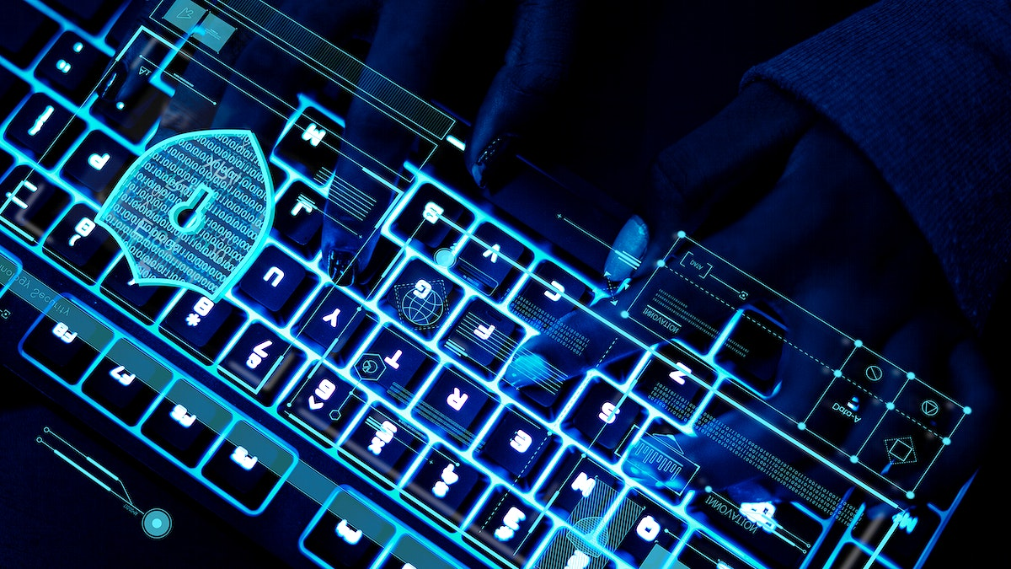
THANK-YOU

